Slide 1
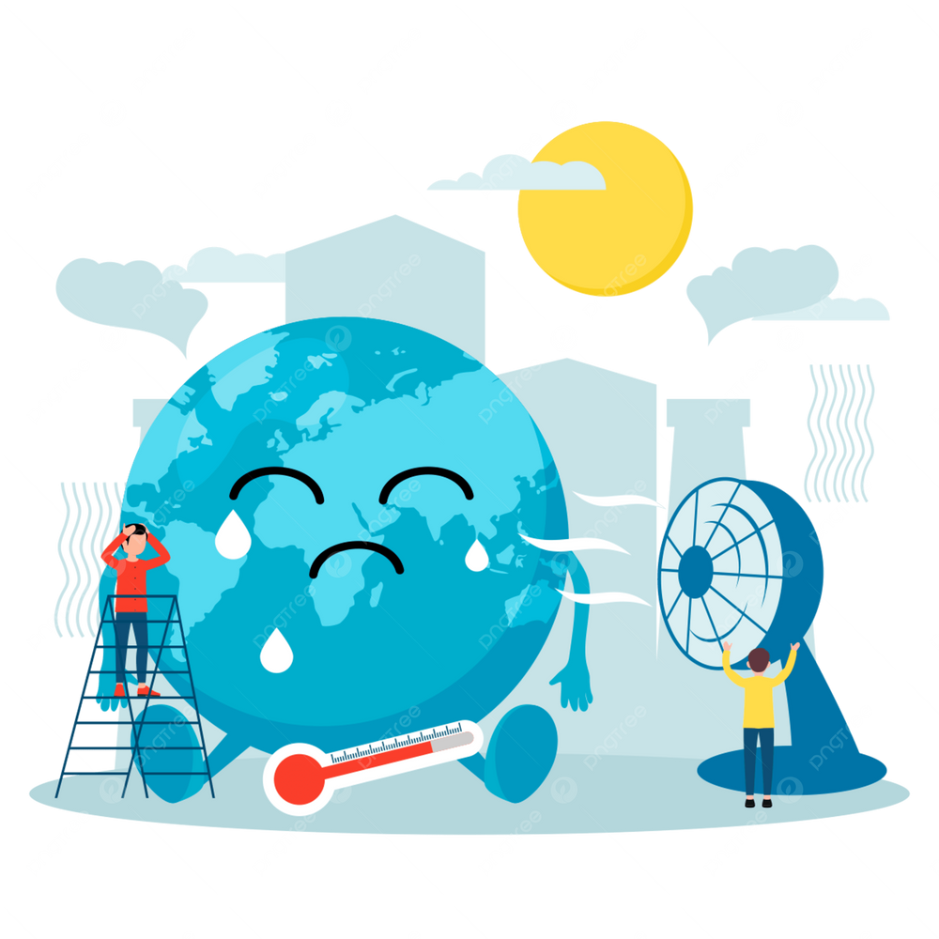


21st September, 2025
SRHR & Climate Change
A Global Crisis
Presented by "Group 3"

Slide 2
"GROUP-3 MEMBERS"
Javeria Ali
Mudasir Naeem
Hajra Hazrat Ali
Maimoona
Unzila
Maria Yaqoob
Mahwish Ali
kishwar Jahan
Kiran Anwar Ali
Muhammad Maraj
Ephrahim Akhtar
Tehreem Khan
Ali Nawaz
Sumera Iqbal
Rashid Hameed

Slide 3
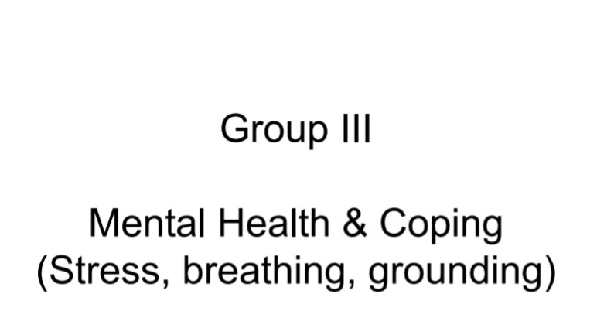

Slide 4

Discussion Points (Mental Health & Coping)
1. Stress
Meaning: A natural reaction of the body when we face challenges, fear, or pressure.
Word Importance: Everyone feels stress – it can be useful (keeps us alert) but too much stress is harmful.
Stress is normal but must be managed.

Slide 5
2. Coping
Meaning: The ways we handle stress and difficult emotions.
Word Importance: Coping tools help us calm down, think clearly, and solve problems.
Talking to a friend, exercising, deep breathing.
3. Breathing (Balloon Breathing Activity)
Meaning: Breathing slowly and deeply, imagining the lungs expanding like a balloon when we inhale, and shrinking when we exhale.
Word Importance: Reduces heartbeat, relaxes muscles, clears the mind.
Simple and can be done anytime, anywhere.

Slide 6

4. Grounding
Meaning: A method to bring ourselves back to the present moment instead of being lost in stress or thoughts. How?
According to the activity
3 things I can see
2 things I can touch
1 thing I can hear
My Example from Activity:
I saw my notebook, my water bottle,
and the screen.
I touched my pen and my chair.
I heard voices of people talking in the room.

Slide 7
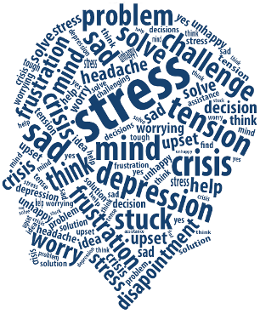
Conclusion/Message
Stress is part of life, but tools like breathing and grounding help us cope better.
These activities make us calm, focused, and less anxious.
We can use them before exams, interviews, or whenever we feel nervous.

Slide 8
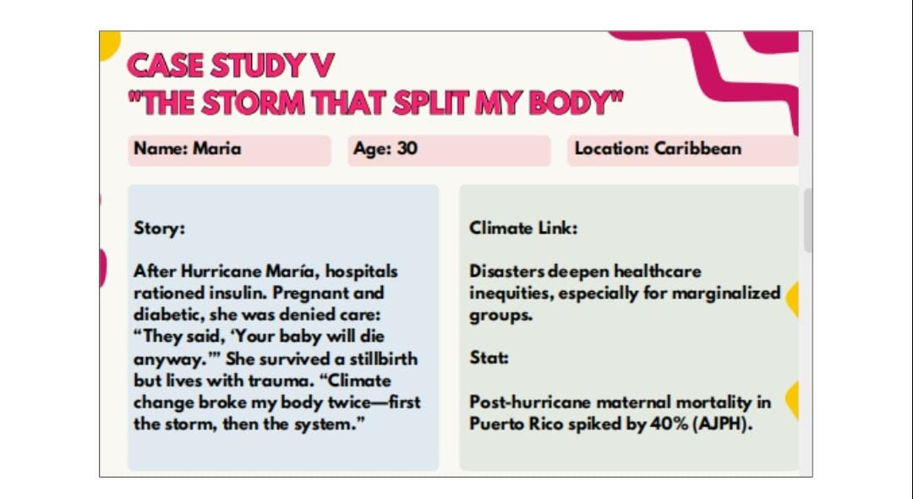

Slide 9
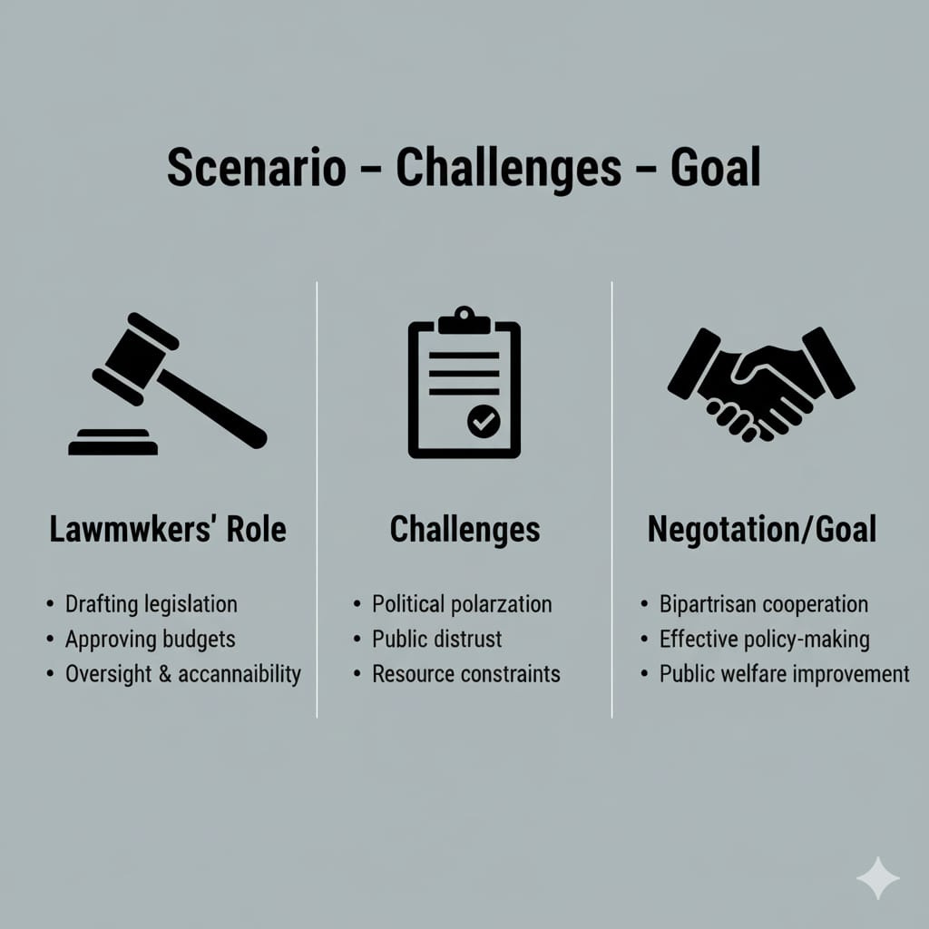
"Case-Study V"

Slide 10

Lawmaker’s Pledge for Maria’s Case
“No mother should lose her child because a storm or a system failed her.”
Guarantee Lifesaving Care - Mandate emergency stockpiles of insulin and prenatal supplies, backed by solar-powered hospitals and mobile maternal clinics.
Ban Discrimination in Crisis - Enforce a No Refusal of Care law so pregnancy, chronic illness, or poverty can never be reasons to deny treatment.
Protect and Heal - Fund trauma counseling and community hotlines so families receive mental-health support and clear information during disasters.
Climate-Proof Health Systems - Integrate sexual and reproductive health into all climate-adaptation plans, with strict oversight and penalties for hospitals that ration care.

Slide 11

Challenges Maria face
1. Health & Medical Challenges
Insulin shortage and rationing left her diabetes untreated.
Denied prenatal care with the statement: “Your baby will die anyway.”
High risk of maternal mortality because emergency services collapsed.
Lack of mental-health support after the stillbirth and trauma.
2. Social & Equity Challenges
Marginalization of vulnerable groups such as pregnant women and people with chronic illnesses.
Gender bias-women’s reproductive health needs overlooked in disaster planning.
Economic barriers to private or alternative medical care.
3. Climate & Infrastructure Challenges
Hurricane damage disrupted power, transport, and medicine supply chains.
Destroyed or inaccessible hospitals and clinics delayed urgent treatment.
Overall breakdown of essential services during the climate disaster.
4. Policy & Governance Challenges
Inadequate disaster-preparedness plans; no emergency stockpiles of vital medicines like insulin.
Lack of oversight on hospital rationing policies, enabling discriminatory triage.
Underfunded maternal-health programs with no contingency for climate emergencies.
5. Economic & Livelihood Challenges
Possible loss of income due to storm damage or job disruption.
Cost of rebuilding homes or relocating reduced ability to pay for continued healthcare.
6. Psychological & Community Challenges
Severe emotional trauma and grief from the stillbirth.
Potential separation from family or community support because of displacement.

Slide 12
Negotiating a Climate-Resilient Recovery Plan
1. Build Consensus
Convene federal, provincial, and local lawmakers to agree on shared goals despite political differences.
Establish a cross-party task force for climate and SRHR (sexual and reproductive health rights).
2. Prioritize Limited Resources
Create a transparent budget that directs every rupee to the most urgent, life-saving needs.
Balance immediate relief (shelters, mobile clinics, food) with long-term adaptation (flood-resistant housing, renewable energy, climate-smart agriculture).
3. Address Health & SRHR Gaps
Ensure reproductive and maternal health services, including mobile care units, are part of all emergency plans.
Provide safe birthing spaces, contraception, and mental-health support for women and vulnerable groups.
4. Include Vulnerable Voices
Involve women, youth, rural farmers, minorities, and displaced families in decision-making forums.
Set up local advisory councils to keep solutions equitable and community-driven.
5. Mobilize External Support
Negotiate grants or low-interest loans from international climate funds, UN agencies, and development banks.
Offer incentives for private-sector investment in green infrastructure and clean energy.
6. Ensure Transparency & Accountability
Require regular public progress reports and independent financial audits.
Create citizen-monitoring committees to track delivery of promised services.
7. Turn Crisis into Opportunity
Use the rebuilding process to embed climate resilience—stronger health systems, renewable energy, and sustainable jobs-so communities are better protected against future disasters.

Slide 13
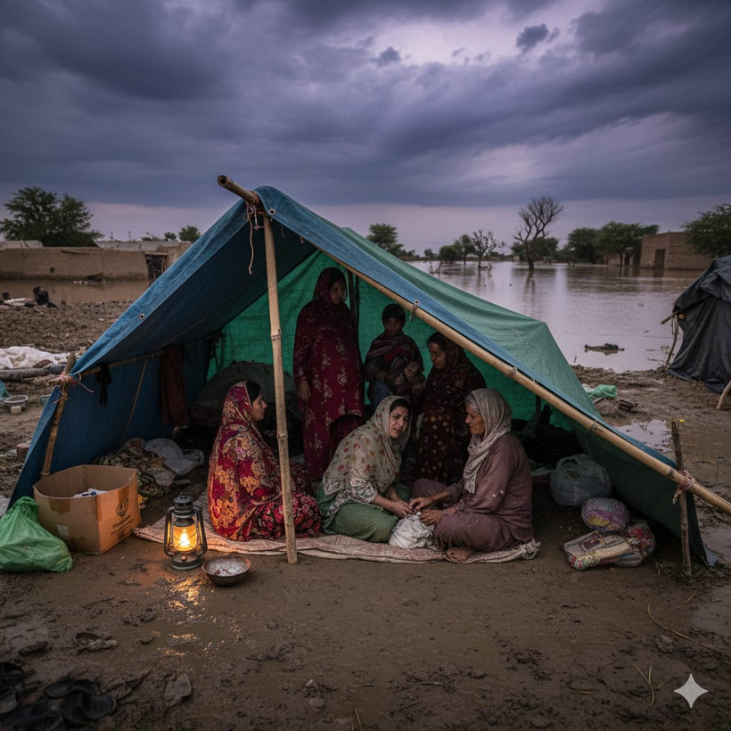
Pregnant Women in Crisis
2022 Sindh Floods – Pregnant Women in Crisis
Case Summary
During the 2022 super floods, thousands of pregnant women were trapped in makeshift camps across Sindh with no access to prenatal or emergency care.
The UN Population Fund (UNFPA) reported that around 47,000 pregnant women in Sindh needed immediate medical attention.
Many were forced to give birth in unsafe conditions, lacking medicine, privacy, and skilled health staff.
“Over 47,000 pregnant women in Sindh require urgent maternal health services.”
Specific Example
“I gave birth in a tent, without a doctor, while floodwater surrounded us,”
Razia Bibi, a 22-year-old from Dadu district, recounted in interviews after the 2022 floods.
Verified Source
UNFPA Pakistan – Situation Report (Sept 2022)

Slide 14
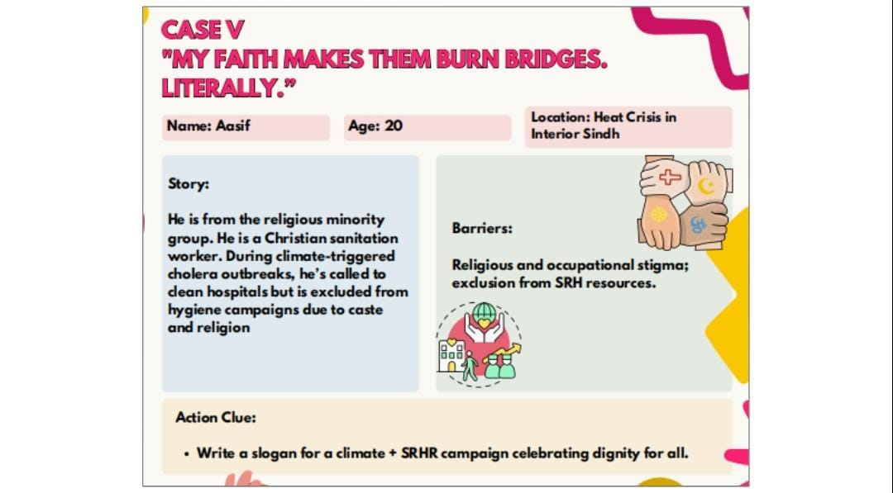

Slide 15

Slogan
"Faith Can’t Filter Rights-Care for Every Climate Survivor"
Core Message
Storms Don’t Discriminate reminds everyone that climate disasters hit every faith, caste, and profession equally.
Heatwaves, cholera outbreaks, or floods don’t stop at religious boundaries.
By contrast, Neither Should Our Care demands that human responses-health care, hygiene campaigns, reproductive services-must also be universal.
This pairing delivers a sharp, memorable call to action:
If nature is impartial, society has no excuse for exclusion.

Slide 16

Presented by "Group 3"

